Slide 1
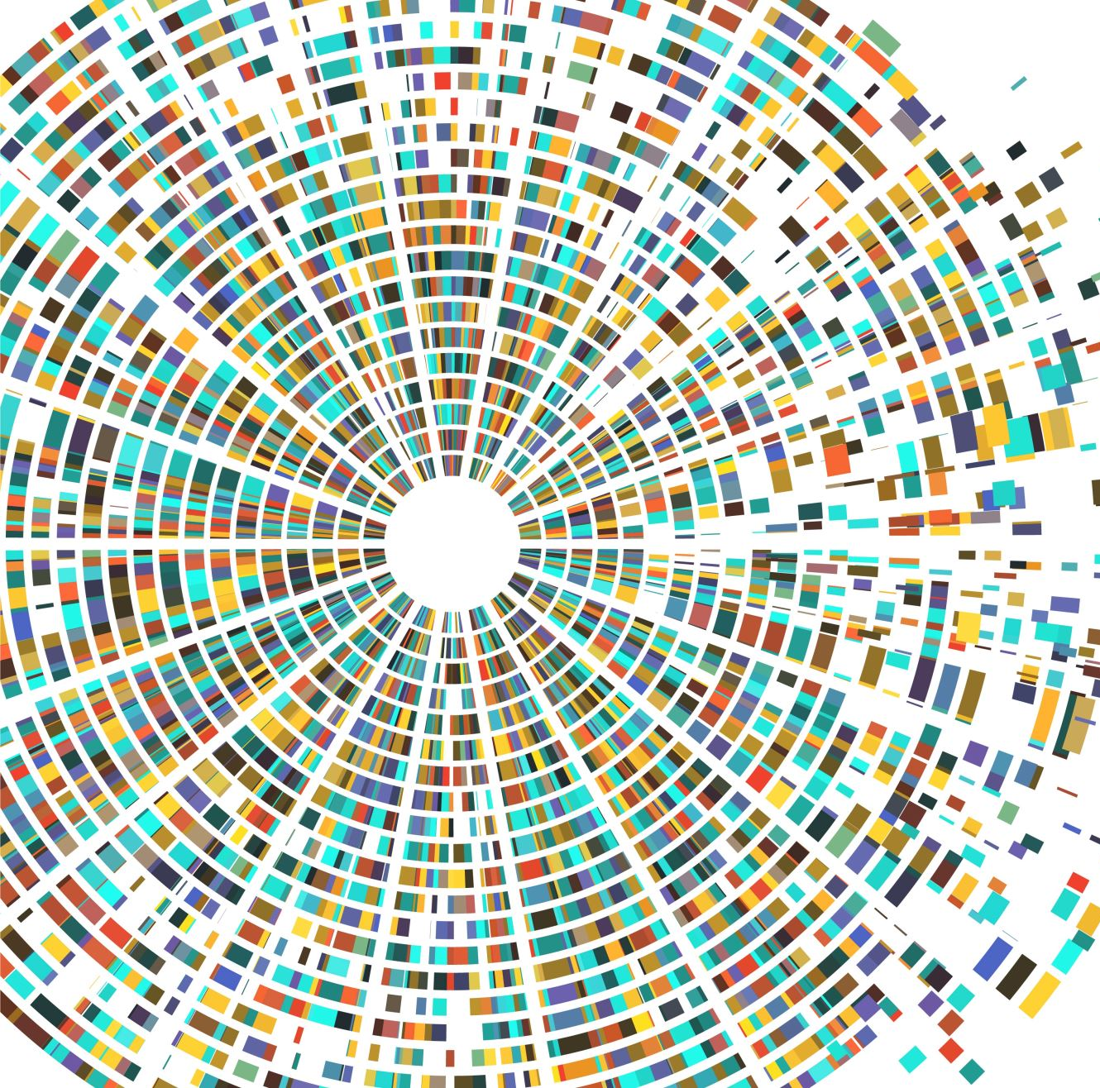
Game Engine Architecture Project (Name Pending)
By Mantas Lazauskas

Slide 2
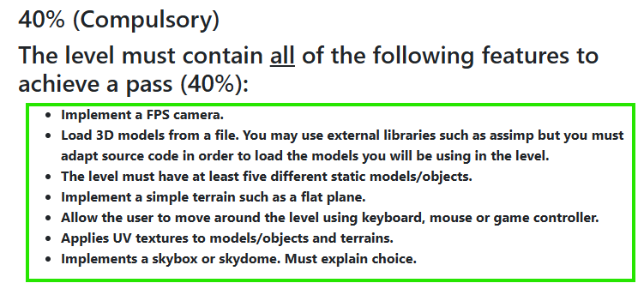
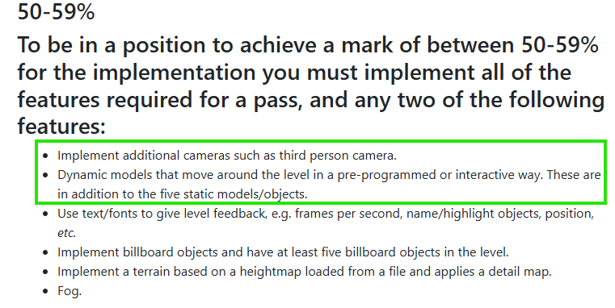
Overview
The theme of the game is a mythology first person arena fighter. These are the features I would like to implement before the deadline.

Slide 3
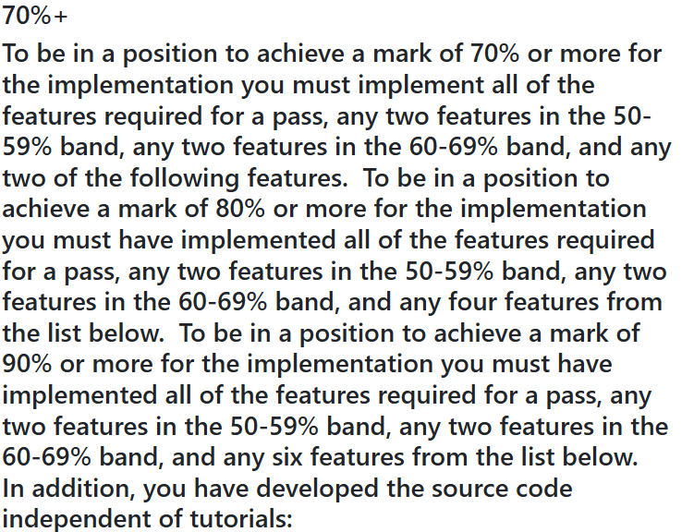
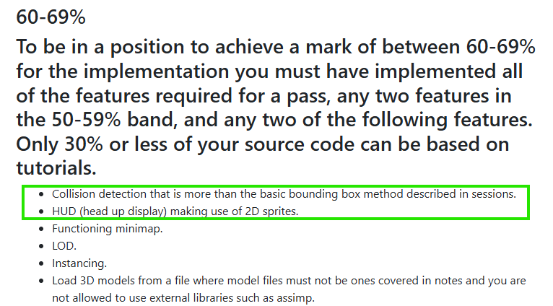
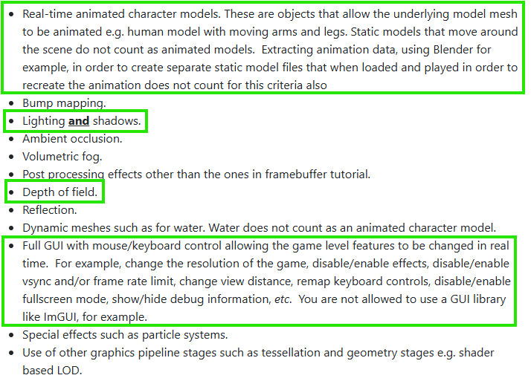

Slide 4
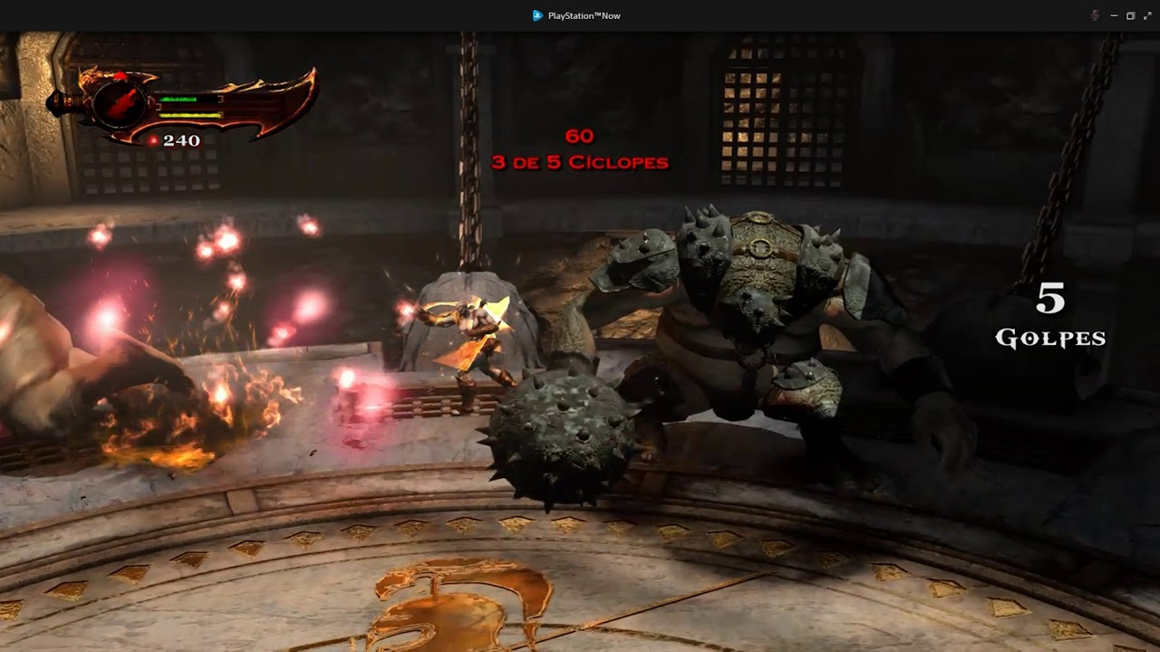
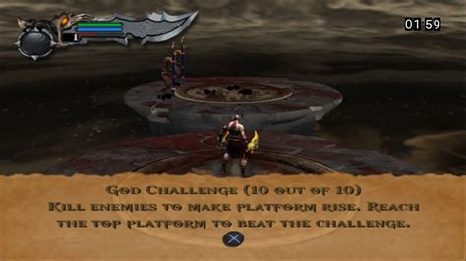
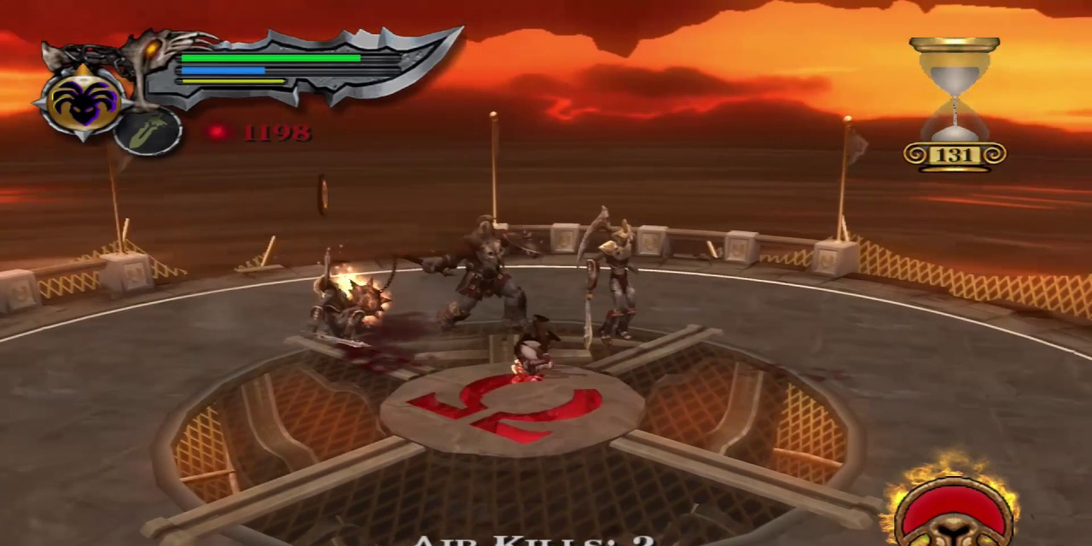
Illustration
I’ll be taking inspiration from the Challenge of the Gods/Titans/Olympus levels that were in the God of War Trilogy.

Slide 5

Current Progress
At the time of presenting this presentation, I have implemented almost all the 40% features except the five static models. However, there was an issue with GitHub, so I’ll have to redo the FPS camera and keyboard movement.

Slide 6
How well am I meeting my development plan?
I would say that I am only slightly behind where I would want to be, which is having all the 40% features implemented by now. Completing it will only take a few hours, and I can then start to implement the feature from the other percentages. To make sure I don’t lose progress, I’ll have to start committing more frequently on GitHub to make sure that I don’t have to redo code that I’ve already done.

Slide 7

Any Questions?

